Slide 1
Outlier Detection
Myron OUyang
u16008368

Slide 2
The Problem
What is the problem?
Can cause bias in results of data analysis
Causes of problem
Errors
Existence of data points that deviate from the rest of the data
Affects the mean value of data
Genuine extreme values
Why should this problem be solved?

Slide 3
Problem Solution
Detect Outliers in data
Exteme Value Analysis
Distance measures
Angle-based Outlier Degree
SmartSifter
AutoEncoder
Treat Outliers in data

Slide 4
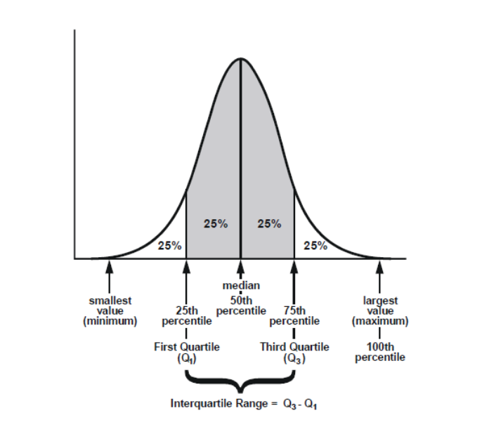
Extreme Value analysis
Basic outlier detection method
Find statistical tails in distribution of data
Data points at extreme ends of tails are the outliers
Use Gaussian distribution or
Calculate inter-quantile range of data

Slide 5
Distance measures
Mahalanobis distance (MD)
“Distance between two points in multivariate space”
Measures distance from central point
Central point – total mean of ALL the multivariate data
The further away a data point is from the central point, the greater the MD
Cook’s Distance (CD)
Measures how much the expected outcome will change provided the current data point is dropped
Common threshold value is 4 times the mean
Therefore any change in expected outcome greater than the threshold can be considered influential

Slide 6
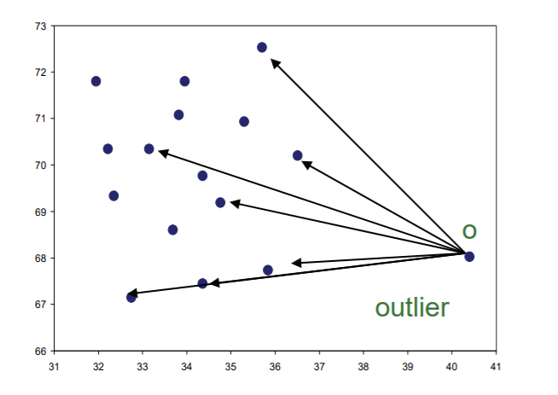
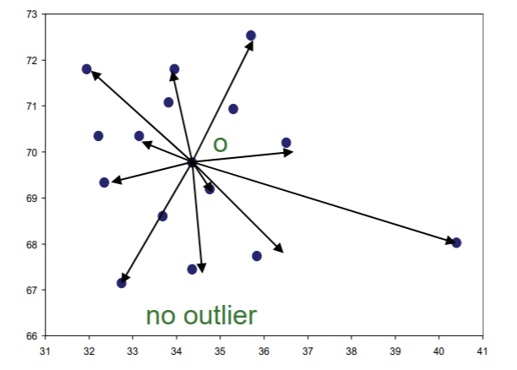
Angle-based outlier detection
Angles are more stable than distances when working with high-dimensional data
Based on the variance of the angles between a point and all the other points in data set
Outlier if majority of other data points are in similar direction
Not outlier if other data points are in varying directions

Slide 7
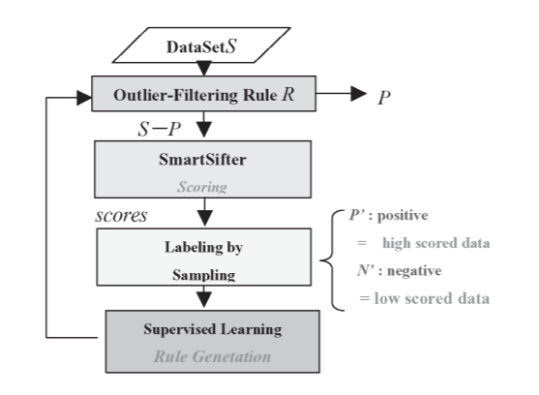
SmartSifter
Construct a model in which data is filtered through
The model is probabilistic and it is affected by each data point passing through it
Filter each data points successively through the model
Data point is an outlier if the model changes significantly

Slide 8
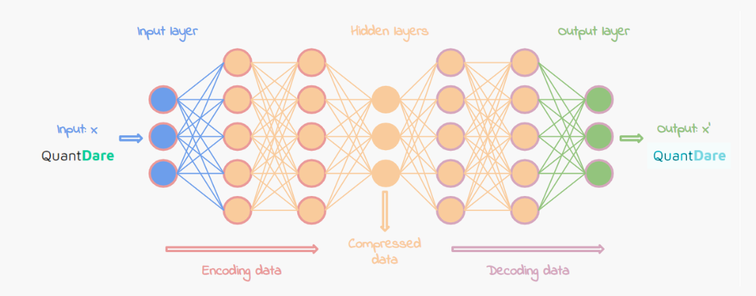
Autoencoder
Unsupervised artificial neural network
Two stages: Encode & Decode
Encode
Compresses data, removes noise/ unnecessary information
Decode
Reconstructs data from compressed data
Compressing data forces NN to only learn the important features (outliers are revealed when the main features are filtered out)

Slide 9
REferences
Extreme value analysis (EVA) of inspection data and its uncertainties - ScienceDirect [WWW Document], n.d. URL https://www.sciencedirect.com/science/article/pii/S0963869517300488 (accessed 10.27.19).
Mahalanobis Distance: Simple Definition, Examples - Statistics How To [WWW Document], n.d. URL https://www.statisticshowto.datasciencecentral.com/mahalanobis-distance/ (accessed 10.27.19).
Cook’s Distance / Cook’s D: Definition, Interpretation - Statistics How To [WWW Document], n.d. URL https://www.statisticshowto.datasciencecentral.com/cooks-distance/ (accessed 10.27.19).
Yamanishi, K., Takeuchi, J.I., Williams, G. and Milne, P., 2004. On-line unsupervised outlier detection using finite mixtures with discounting learning algorithms. Data Mining and Knowledge Discovery, 8(3), pp.275-300.
Chen, J., Sathe, S., Aggarwal, C. and Turaga, D., 2017, June. Outlier detection with autoencoder ensembles. In Proceedings of the 2017 SIAM International Conference on Data Mining (pp. 90-98). Society for Industrial and Applied Mathematics.
Outliers detection with autoencoder, a neural network | Quantdare [WWW Document], n.d. URL https://quantdare.com/outliers-detection-with-autoencoder-neural-network/ (accessed 10.27.19).
Pham, N., 2018, September. L1-Depth Revisited: A Robust Angle-Based Outlier Factor in High-Dimensional Space. In Joint European Conference on Machine Learning and Knowledge Discovery in Databases (pp. 105-121). Springer, Cham.

